Slide 1
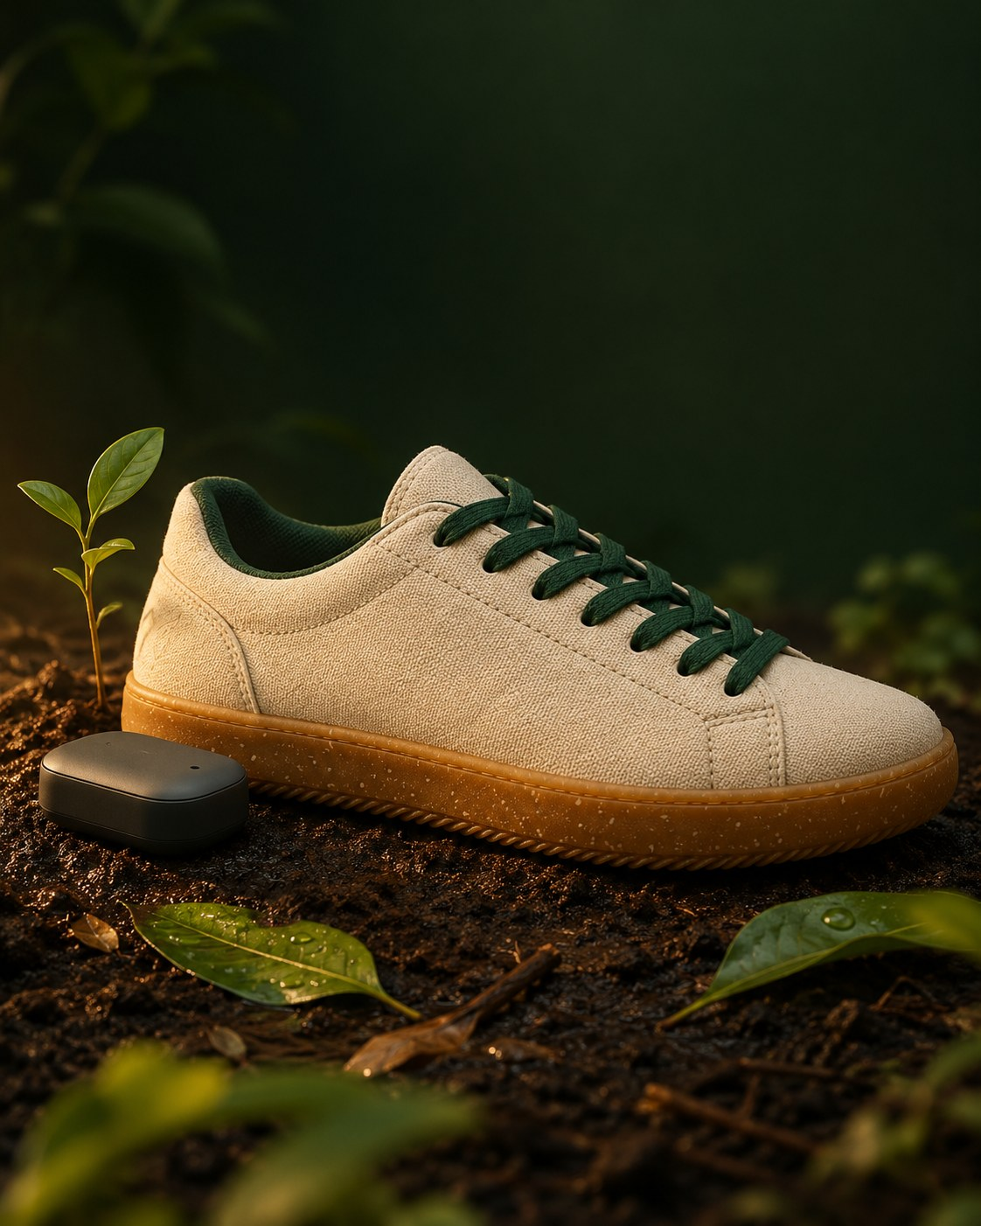
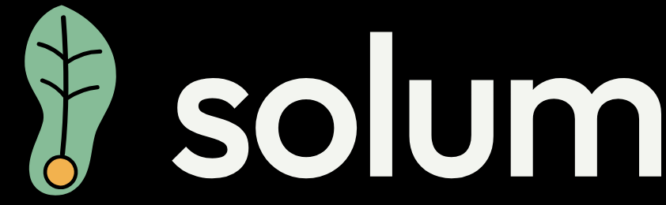
Biodegradable smart footwear that reads your health from every step
Reads every step. Returns to the soil.
Track 06: Bioplastics and Biomaterials
Team Neura, Kristu Jayanti University
Arfa Zainab, Shreeji Jha, Uttara H
Bioeconomy Hackathon 2026, Southern Region | IFGTB, Coimbatore | 13 October 2026
Notes:
About 15 seconds.
"Good morning. We are Team Neura from Kristu Jayanti University, Track 06. Solum is smart footwear that reads your health from every step, and is built to return to the soil."
The photo is a concept render of the Solum Shoe. Solum is Latin for ground and soil, and it is where the English word "sole" comes from.

Slide 2
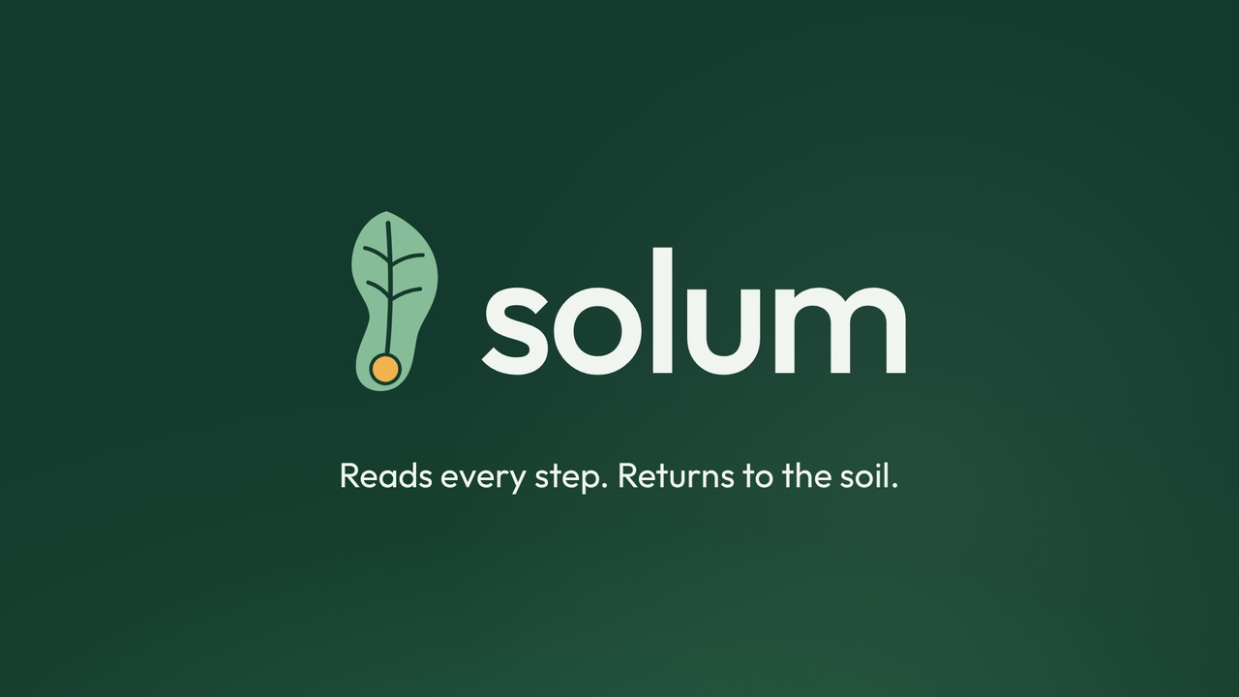
Notes:
About 1 minute. Click the video to play it. It runs 58 seconds, with music, so check the room's sound before you start.
Let it play without talking over it. When it ends, say: "That is Solum. Now let me show you why it matters."
If the video will not play, skip this slide: the live demo covers the same ground.

Slide 3
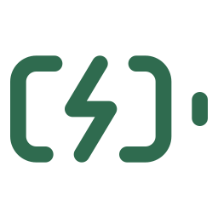
Shoes are made from oil, glued shut, and thrown away
Problem: waste
23.9 bn
90%
65
pairs of shoes were made worldwide in 2024. India made 12.5% of them, the second largest share.
of discarded shoes end up in landfill or are burned. Only about 5% are recycled.
parts can go into one running shoe, nearly all glued together, so it cannot be taken apart.
Smart shoes add batteries and circuit boards to the same pile.
India generated 17.5 lakh tonnes of e-waste in 2023-24 and formally recycled less than half. The cost lands on cities, waste pickers, and the soil and water around dumps.
Sources: World Footwear Yearbook 2025 (APICCAPS); Fashion for Good and Circle Economy, Closing the Footwear Loop; MIT Sloan Sustainability Lab; MoEFCC reply in Parliament, 2024.
Notes:
About 40 seconds.
"The world made 23.9 billion pairs of shoes last year, and India made one in eight. About 90 percent of discarded shoes are landfilled or burned, because a shoe is up to 65 glued parts made from oil-based foams and rubbers. Smart shoes now add batteries and circuit boards to the same pile, at a time when India formally recycles less than half its e-waste."

Slide 4
How you walk is an early health signal that nobody reads
Problem: unread health signals
12 years
Walking speed began slowing about 12 years before mild cognitive impairment was diagnosed, in a 20-year ageing study.
4 years
Irregular, uneven steps picked up by a wearable sensor appeared about 4 years before a Parkinson’s diagnosis.
Buracchio et al., Archives of Neurology, 2010
Del Din et al., Annals of Neurology, 2019
86%
fewer foot-ulcer recurrences in people with diabetes whose pressure-sensing insoles alerted them, when worn 4.5+ hours a day.
34,000+
older adults across nine studies: their walking speed predicted how long they would live.
Abbott et al., Lancet Digital Health, 2019
Studenski et al., JAMA, 2011
India has 101 million people with diabetes and 149 million aged 60 and over. A wrist band can’t see these signals, and a clinic sees them once a year at best. Solum does not diagnose; it spots the change early and says when to get checked.
Sources: as cited on each card; ICMR-INDIAB study, Lancet Diabetes and Endocrinology, 2023; UNFPA India Ageing Report 2023.
Notes:
About 50 seconds. This is the slide that explains why Solum matters beyond sustainability.
"There is a second problem. How you walk carries early health signals, and nobody reads them. In a 20-year study, walking speed started slowing about 12 years before people were diagnosed with mild cognitive impairment. In another study, irregular and uneven steps measured by a wearable showed up about 4 years before a Parkinson's diagnosis. For people with diabetes, pressure-sensing insoles that warned wearers about pressure hotspots cut ulcer recurrence by 86 percent among those who wore them as advised. And across 34,000 older adults, walking speed predicted survival."
"India has 101 million people with diabetes and 149 million over 60. A wrist band cannot see these signals, and a clinic sees them once a year at best."
Say clearly: "Solum does not diagnose. It spots changes against your own baseline and tells you when to get checked."
If asked: the brain studies used gait labs and a lower-back sensor, not shoes. Solum measures the same features, walking speed, step-time variability and asymmetry, from the foot, and validating that is part of our clinical study plan.

Slide 5
Your wrist can’t feel your feet. Solum can.
Existing solutions and gaps
 | Fitness bands and watches | Smart insoles | Eco sneakers | Clinic gait labs | Solum
Pressure and balance, read at the foot | No | Yes | No | Yes | Yes
Gait quality every day, not once a year | Partly | Yes | No | No | Yes
Knee mechanics for athletes | No | No | No | Yes | Yes
AI coaching on how to walk and train | Yes | Partly | No | No | Yes
Body made to biodegrade, electronics reused | No | No | Partly | Not applicable | Yes
Others measure the wrist or ignore the planet. Solum reads your health from the ground up, and goes back to the ground when it is worn out.
Notes:
About 30 seconds.
"Fitness bands and watches read your heart and estimate steps from how your arm swings. They cannot feel pressure under your foot, see your balance, or measure your knee. Smart insoles sense pressure but are medical niche products that end up as e-waste. Eco sneakers sense nothing. Clinic gait labs are accurate, but you visit once."
"Solum is the only option in this table that reads pressure, gait and knee mechanics every day, coaches you on it, and is built to biodegrade with its electronics reused."
Keep it factual: say "we found", not "nothing exists".

Slide 6
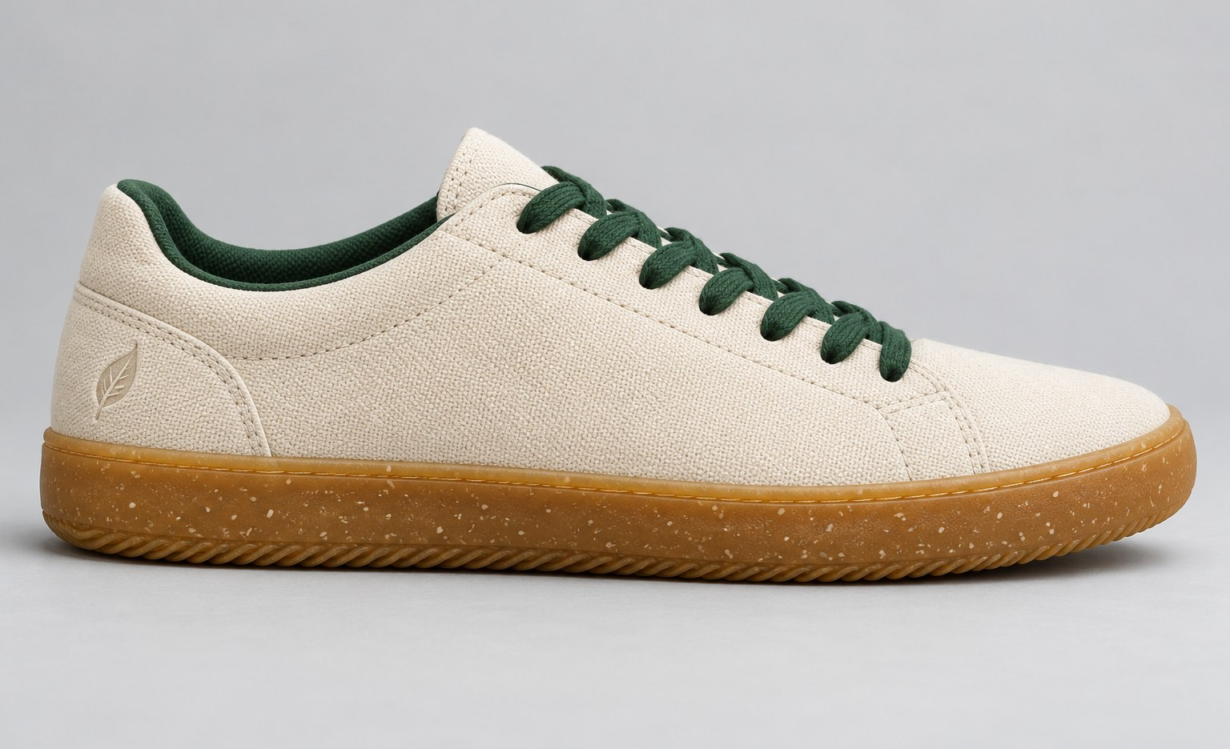
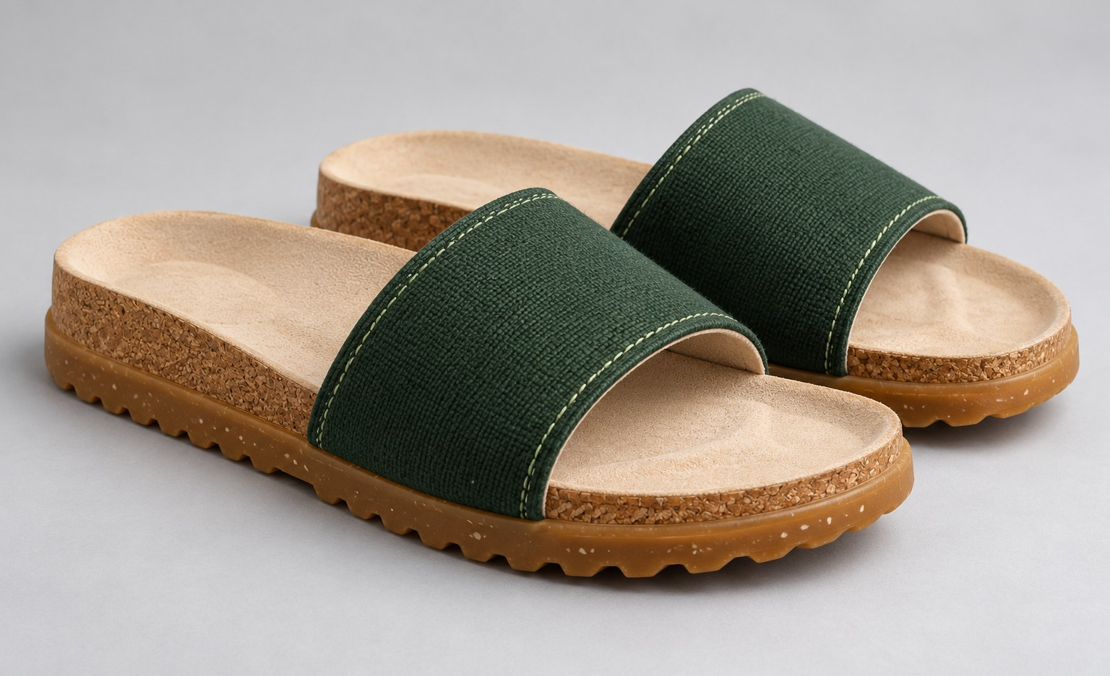
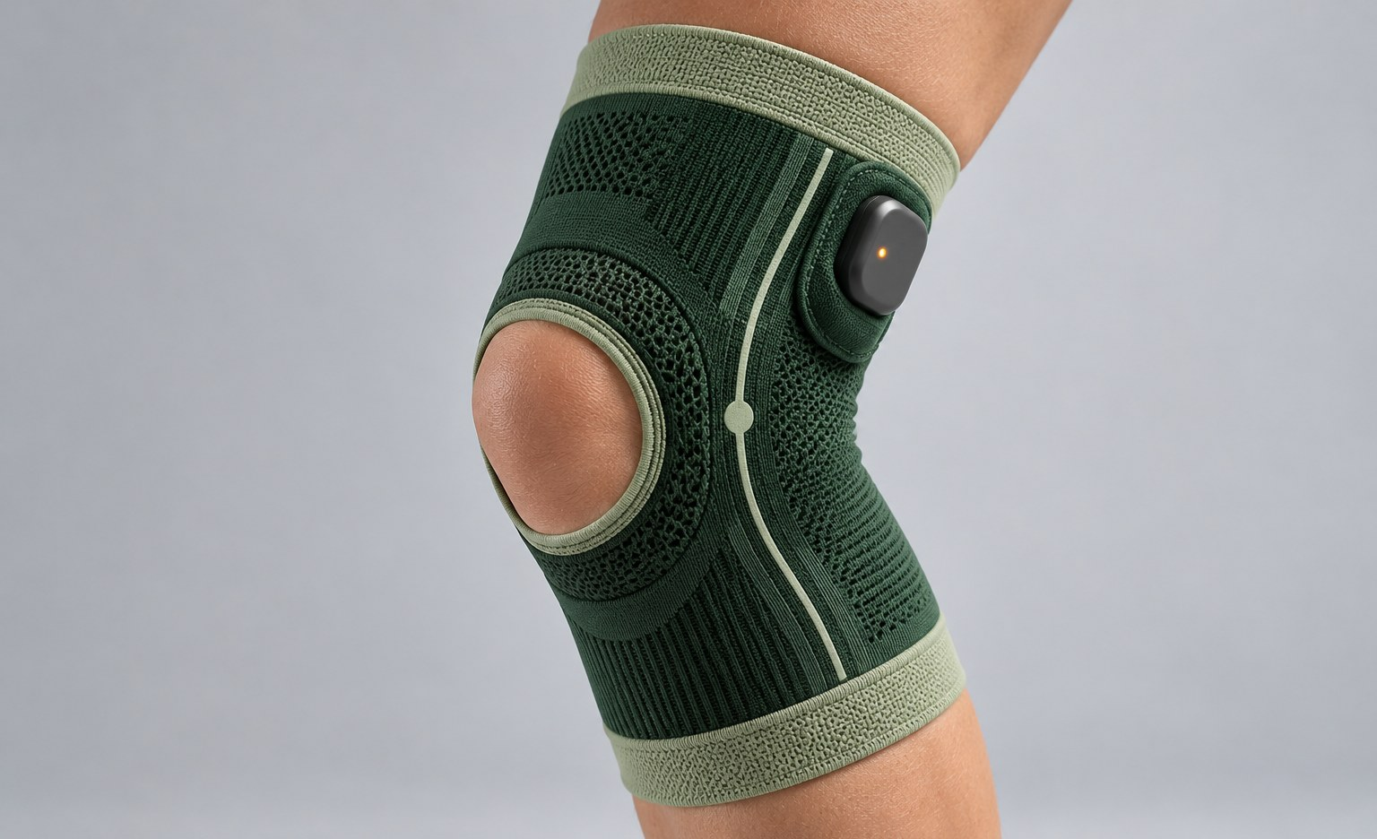
One core, three products, one app
Our solution
Each product has a biodegradable body and the same removable sensor core. The core moves into your next pair, and the app turns every step into health insight.
Solum Shoe
₹9,999
Solum Slide
₹5,999
Solum Knee
₹6,999
Everyday walkers and runners
Older adults at home
Athletes and knee rehab
Senses: Pressure film and motion sensor
Tells you: Walking speed, step rhythm, balance and foot strike
Senses: Pressure film, heat map first
Tells you: Steadiness, pressure hotspots and walking-speed trend
Senses: Bend sensor and motion sensor, worn with Solum Shoes
Tells you: Knee bend range, landing load and left-right load
Product images are concept renders.
Notes:
About 45 seconds.
"Solum is three products on one platform. The Shoe is for everyday walkers and runners. The Slide is a home chappal for older adults, with the pressure heat map first, because older people are most at risk from balance and foot problems. The Knee band is for athletes and knee rehab; it adds a bend sensor and works with Solum Shoes."
"All three use the same removable core. The body is biodegradable; the core clips out and moves to your next pair. Our tech is the grey area between a biodegradable life and a biodegradable shoe, so instead of throwing it away, we reuse it."
The product images are concept renders, not photos of built products. Say so if a judge asks.

Slide 7
Seven signals, and what each one can warn you about
What Solum measures
Signal | What it is | What it can flag | From
Walking speed | How fast you walk on an ordinary day | Overall health and frailty. In studies it slowed years before memory problems were diagnosed. | Shoe, Slide
Step rhythm | How regular each step is | Balance problems. Rising variability appeared years before Parkinson’s in one study. | Shoe, Slide
Left-right balance | How evenly your feet share the load | Injury, recovery after a stroke or surgery, overuse. | All three
Pressure map | Where pressure peaks under each foot, and for how long | Diabetic foot-ulcer risk, foot pain, poorly fitting shoes. | Shoe, Slide
Standing steadiness | How much you sway standing still | Balance and fall risk, tracked over weeks. | Slide, Shoe
Steps and cadence | How much, and how briskly, you walk | Daily targets. Health benefit keeps rising up to 6,000 to 10,000 steps, depending on age. | All three
Knee bend and landing load | How far the knee bends, and how hard you land | Knee strain and ligament injury risk, rehab progress. | Knee
Sources: Buracchio et al. 2010; Del Din et al. 2019; Abbott et al. 2019; Paluch et al., Lancet Public Health, 2022; Hewett et al., American Journal of Sports Medicine, 2005.
Notes:
About 45 seconds.
"These are the seven signals Solum reads. Walking speed and step rhythm are the two with the strongest research behind them as early signs of brain and overall health. Left-right balance shows injury and recovery. The pressure map matters most for people with diabetes, where long-lasting hotspots come before ulcers. Standing steadiness tracks balance and fall risk over weeks. Steps and cadence set your daily target. The knee band adds bend range and landing load, which matter for ligament injuries."
Each signal is compared with the person's own baseline, so the app looks for change, not for one bad day.

Slide 8
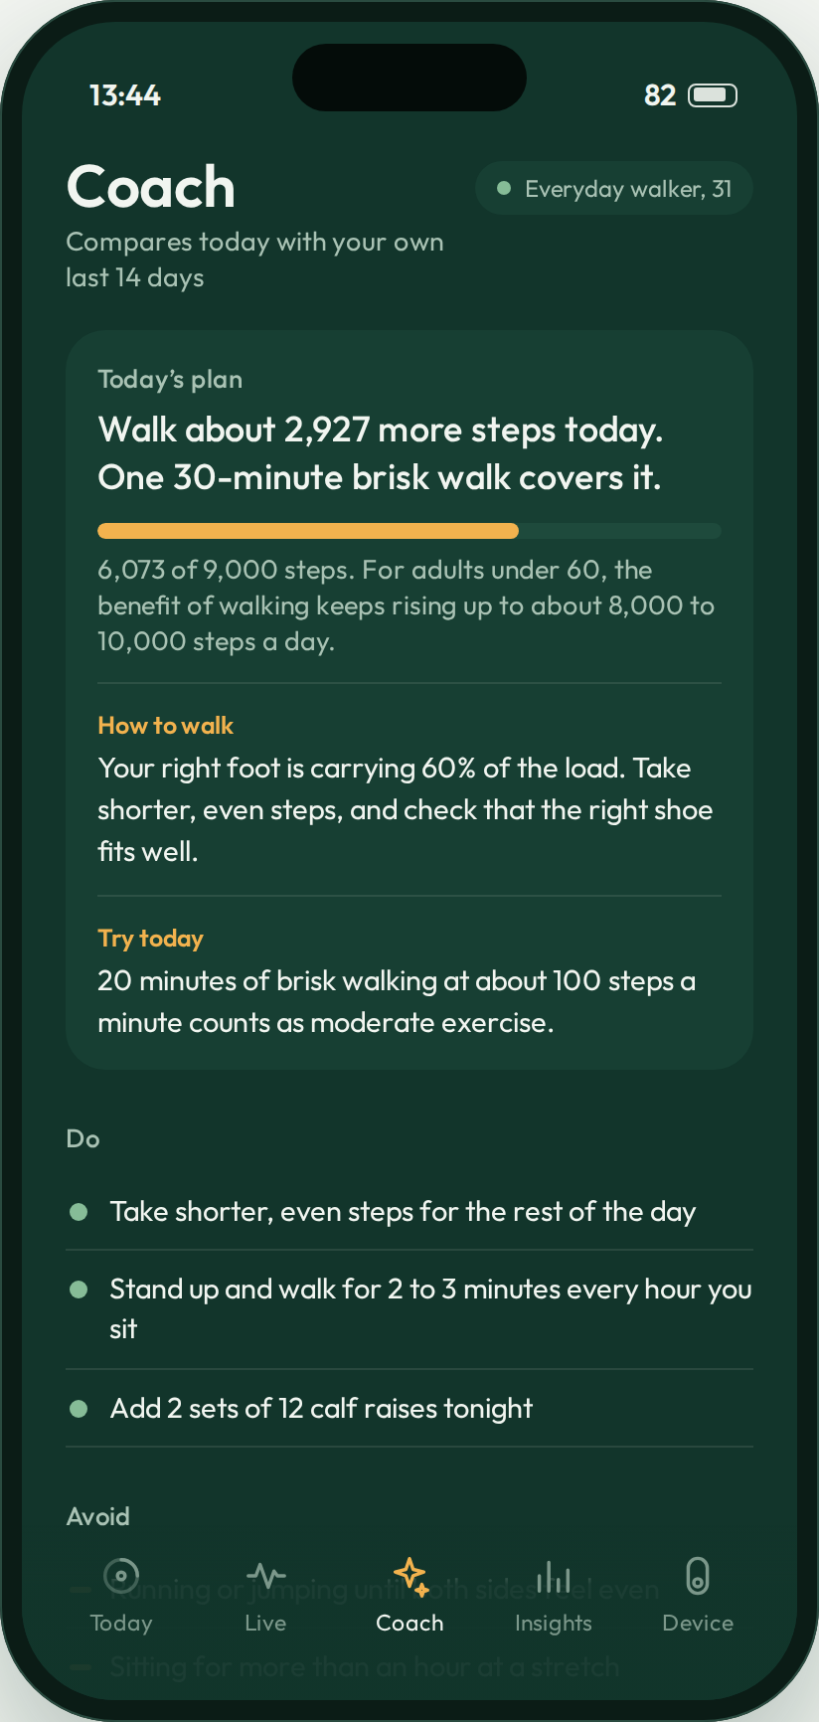
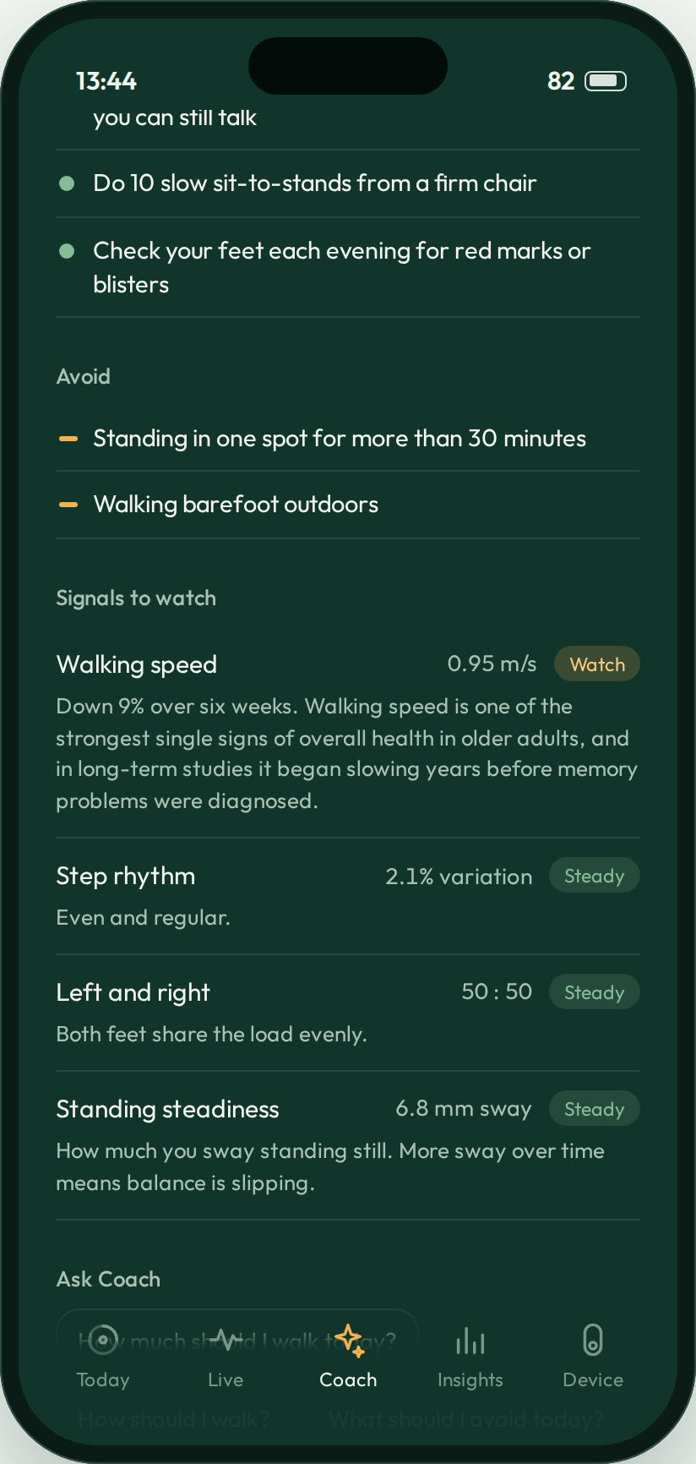
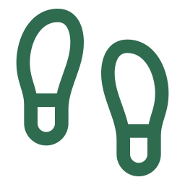
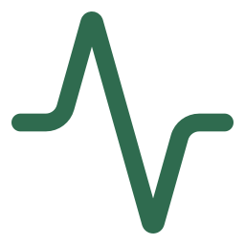



The coach tells you what to do next, in plain words
Solum Coach, AI insights
How much to walk
“Walk about 2,900 more steps today. One 30-minute brisk walk covers it.”
How to walk
“Your right foot is carrying 60% of the load. Take shorter, even steps.”
What to do
“Three rounds of 30-second single-leg balance, holding a chair.”
What to avoid
“Skip jump training today. Your landings are harder than your baseline.”
When to get checked
“Your walking speed has dropped 9% in six weeks. Worth mentioning at your next check-up.”
It compares you with your own baseline, explains every suggestion, and never diagnoses.
Notes:
About 30 seconds. The live demo shows this screen, so keep it short here.
"The Coach is the part people will use every day. It tells you how much to walk, with a target based on research for your age; how to walk, for example evening out your load; what to do, like a balance exercise; what to avoid, like jump training on a day your landings are stiff; and when something is worth checking with a doctor."
How it works: models on the phone compare today's signals with the person's own last 14 days; a language model turns the result into plain sentences. In the prototype, the same logic runs as rules on simulated data.

Slide 9
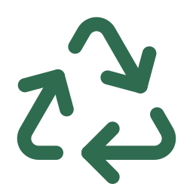

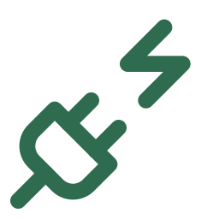
What makes Solum different
Innovation
Health read from the ground up
One core, three bodies
Pressure, gait and balance measured at the foot, where wrist wearables cannot see.
The same sensing core moves between the Shoe, Slide and Knee band, and outlives every shell.
A sole from plants and crop waste
A coach that compares you with yourself
Natural rubber, rice-husk silica and lignin. No oil-based polymer goes into the sole.
Every insight is measured against your own baseline, so small changes show up early.
Also: one printed pressure film instead of eight sensors, dock charging with no ports, and a shoe that tracks its own wear.
Notes:
About 30 seconds.
"Four things are new together. Health is read from the ground up, where wrist wearables cannot see. One core works across three products and outlives every shell. The sole is made from plants and crop waste. And the coach compares you with yourself, so a small change stands out."
Originality, if asked: each ingredient has been studied, and gait research exists; putting a biodegradable product line, a reusable core and a personal coach together is the new part.

Slide 10
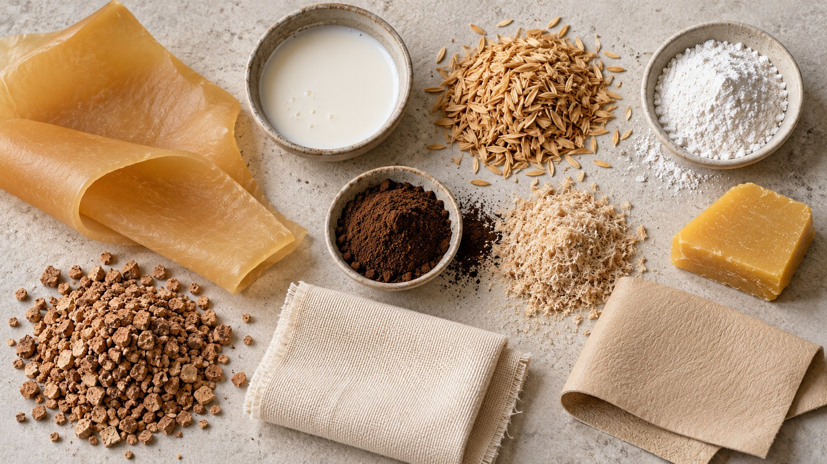
A sole from a rubber tree, a rice mill and sawdust
Technology: materials
Natural rubber, 62%
Insole, top to bottom
Latex tapped from Hevea trees in Kerala. Flexible, waterproof, grips.
Cotton top fabric
Rice-husk silica, 25%
Mycelium leather, 1-2 mm
From rice-mill husk ash, which is about 90% silica. Harder wearing, handles heat.
Cork granules and natural latex, 3-5 mm
Lignin, 6%
From rubberwood sawdust or paper-mill waste. Blocks UV and slows ageing. Kept near 10 parts per 100 rubber, as more makes the sole stiff.
Illustrative image of the raw materials.
Natural rubber base
0%
oil-based polymer in the sole. One tree gives both the latex and the sawdust lignin.
Curing aids, 7%
A peroxide cure with magnesium oxide, so no sulfur. The only part that is not plant-based.
Upper: organic cotton canvas. Glue: natural latex. Thread: cotton.
Knee band: natural rubber foam in place of neoprene, with an organic cotton knit.
Sole
by weight
Beeswax finish
Rubbed on top for extra water resistance.
Sources: Intapun et al., Polymers 13(7), 2021; Mahidol University, Journal of Composites Science 6(12), 2022; Lv et al., Iranian Polymer Journal 32, 2023.
Notes:
About 25 seconds.
"The sole is about 62 percent natural rubber, 25 percent rice-husk silica and 6 percent lignin from rubberwood sawdust, so one tree gives two ingredients. The other 7 percent is the curing package: a peroxide with magnesium oxide. We cure without sulfur, and the peroxide forms carbon-to-carbon crosslinks that hold up well to heat. The insole is cotton, mycelium leather and cork with natural latex. The knee band uses natural rubber foam instead of neoprene."
Why no zinc oxide either: it mainly helps sulfur cures, and zinc washing out of rubber harms soil and water life, so a sole meant for the soil is better without it.
Why no magnetite: an earlier draft had 20 to 30 percent magnetite for UV and electromagnetic shielding. We dropped it because it is heavy, it is mined rather than grown, and a sole does not need EM shielding. Lignin already blocks UV. Lignin is capped near 10 parts per 100 rubber because research found properties drop above that.

Slide 11
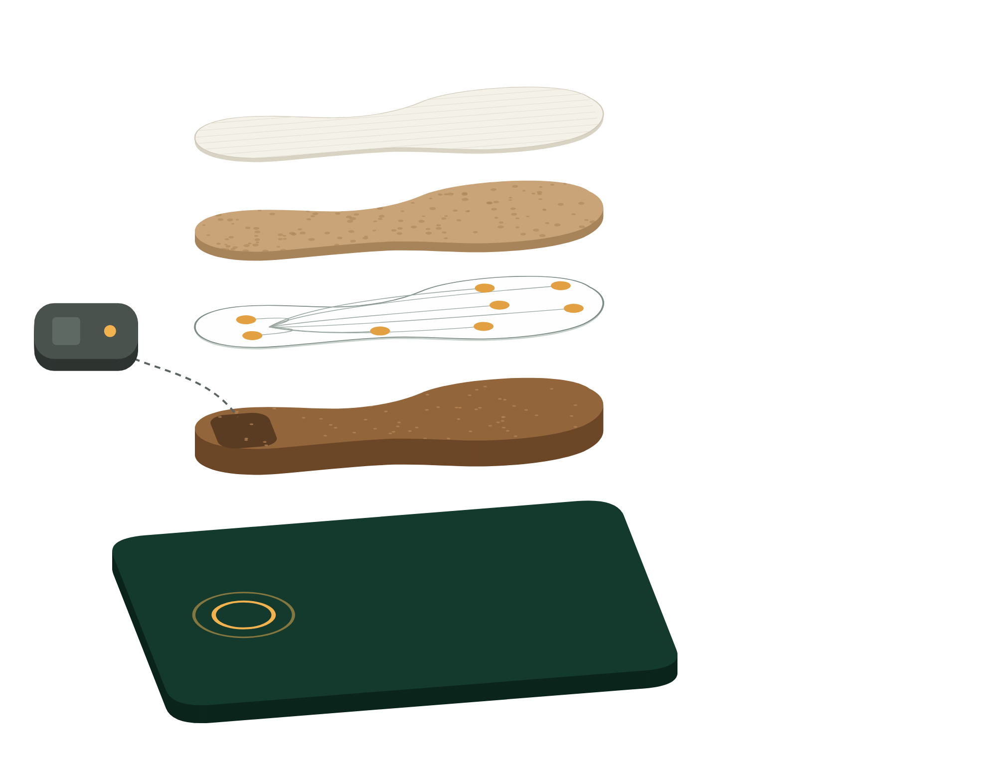


Simple sensors, one small cell, no plugs
Technology: sensing core
Pressure film
One printed sheet under the insole, 8 zones per foot. Builds the heat map. Shoe and Slide.
Cotton top
Motion sensor
Mycelium and cork-latex cushion
Steps, speed, stride and foot strike. In the Shoe and the Knee band.
Core, clips into the heel
Pressure film, 8 zones
Bend sensor
A printed strip across the knee measures how far it bends. Knee band only.
Sole: rubber, silica, lignin
Core and dock
Bluetooth, memory and a small sealed cell, cushioned in the heel. Charges on the dock, about a week per charge.
Logs 100 times a second
Stores steps when the phone is away
Syncs over Bluetooth Low Energy
Coach compares with your baseline
Dock with charging coil
Left out on purpose: GPS, SOS, fall alarms and lights. Your phone already does those.
Notes:
About 25 seconds.
"Each product uses at most two sensors. Shoes and slides have one printed pressure film; the shoe and knee band have a motion sensor; the knee band adds a printed bend sensor. The core holds Bluetooth, memory and a small sealed cell, cushioned in the heel, and charges when you park it on the dock. It logs a hundred times a second, stores steps when the phone is away, and syncs when it is back."
"We left out GPS, SOS buttons, fall alarms and lights. Your phone already does those, and each one costs battery and adds false alarms."

Slide 12
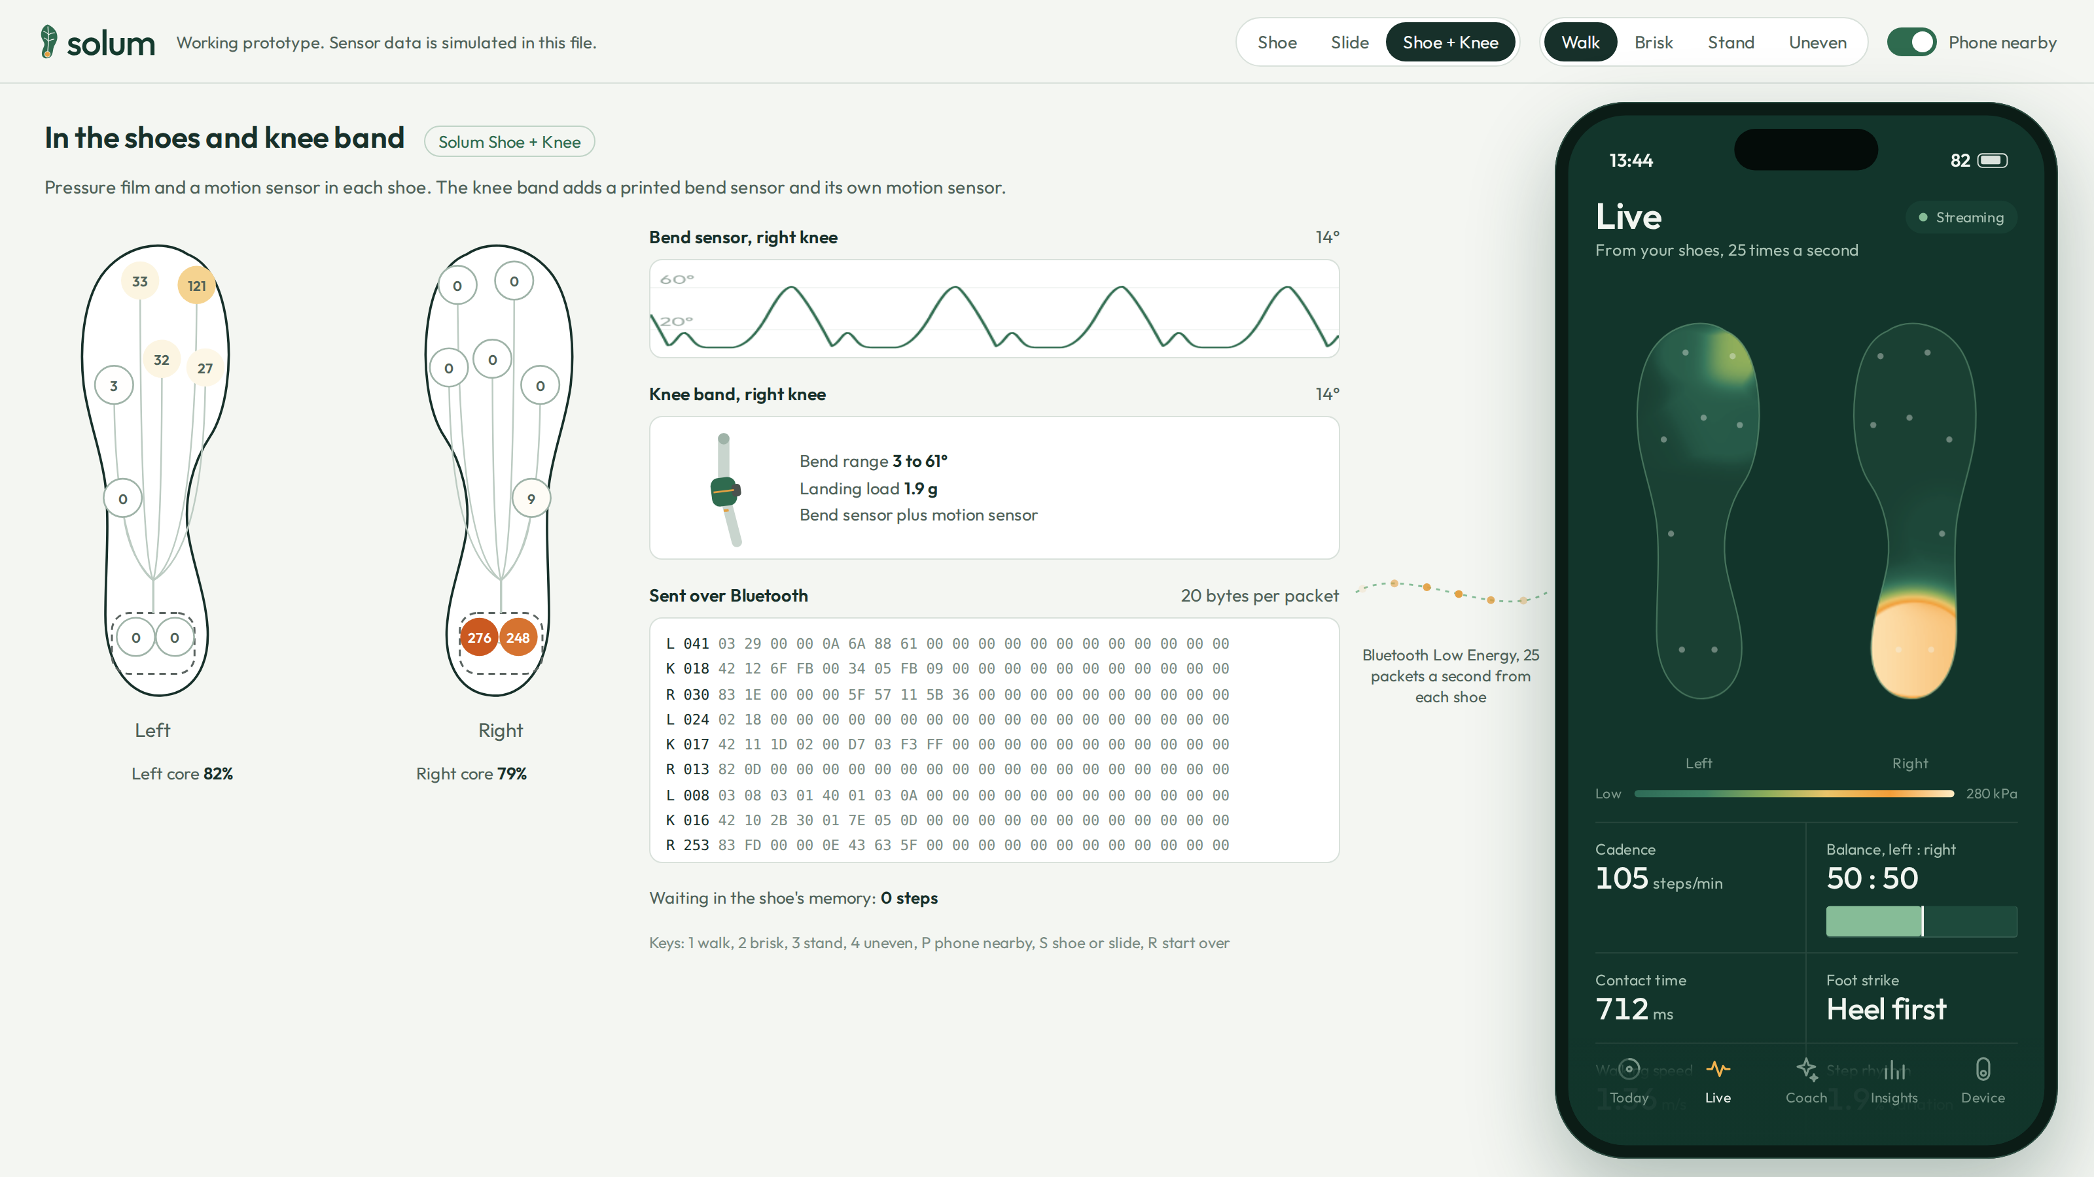

A working app prototype, synced to the shoe and knee band
Prototype
What the live demo shows
1
Pairing, then syncing the steps the shoes stored
2
Live pressure, walking speed and step rhythm
3
Coach: today’s plan, do and avoid, signals to watch
4
Knee band: live bend angle and landing load
5
Phone out of range: the shoe keeps counting, then syncs
Try it on your phone
solumapp.pages.dev
The film and the deck are there too.
Next: three sole recipes, wear tests and a 180-day soil burial.
Runs offline from one HTML file. Sensor data in the demo is simulated; the packet format matches the planned firmware.
Notes:
Live demo, about 3 minutes 30 seconds, since the film has already shown the app. Keep each step brisk, and skip step 6 if time is short. The QR code on this slide opens the same prototype at solumapp.pages.dev, so judges can try it on their phones. Open Solum_App_Prototype.html in Chrome first and press F11 for full screen. No internet needed.
1. Pair (25 s): Find my shoes, then Connect. The shoes stored 4,812 steps while the app was closed, and they sync in.
2. Live (50 s): the soles on the left are the shoe, the phone is the app; each zone lights up in both at once. Point at walking speed and step rhythm. Open "What the shoe sends" to show one decoded packet.
3. Coach (1 min): open Coach. Show today's plan, how to walk, do and avoid. Press 4 for Uneven: the plan changes to "your right foot is carrying 60% of the load" and step rhythm turns to Watch. Tap "Is anything worth checking with a doctor?"
4. Slide (40 s): click Slide. Open Coach: walking speed shows Watch, down 9% in six weeks. This is the early-signal idea.
5. Shoe + Knee (40 s): click Shoe + Knee, then Live. The leg on the left bends in real time; the app shows bend range and landing load. Press 2 for Brisk and open Coach: it says skip jump training today.
6. Phone away (25 s): press P. The shoe keeps logging; press P again and it syncs.
Say once: "The sensor data is simulated. The data format and the coach logic are what the real product will use." Keys: 1 to 4 modes, P phone nearby, S cycles products, R starts over.

Slide 13
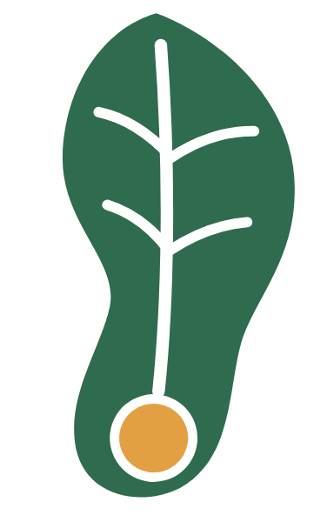
What each pair saves, and where it goes after
Sustainability and environmental impact
93%
of the sole by weight comes from plants or crop waste.
Grow
Make
Rubber latex, rice-husk ash, sawdust lignin and beeswax.
Compounded and moulded into the shell, glued with natural latex.
~190 g
of rice-husk silica and lignin in every pair, made from waste streams.
0
batteries thrown out with any product. The core moves to the next one.
Return
Walk
Shell to soil or compost. Core to the next shell. Dead cores to authorised e-waste recyclers.
The core reads every step, for about a year per shell.
60 t
of synthetic sole material avoided for every 1 lakh pairs sold.
How it breaks down: soil bacteria such as Streptomyces and Gordonia cut rubber chains with latex-clearing protein, white-rot fungi break down lignin, and soil microbes digest cotton and mycelium. Vulcanised rubber is slower than raw latex, so our first lab test is a 180-day soil burial.
Sources: Frontiers in Microbiology (2024) and Brazilian Journal of Microbiology on rubber-degrading bacteria; E-Waste (Management) Rules, 2022. Per-pair figures assume a 300 g sole per shoe.
Notes:
About 45 seconds.
"93 percent of the sole comes from plants or crop waste; each pair uses about 190 grams of rice-husk silica and lignin; no battery is thrown out with any product; and every lakh pairs avoids about 60 tonnes of synthetic sole material."
"Soil bacteria like Streptomyces and Gordonia break rubber down with an enzyme called latex-clearing protein. Vulcanised rubber is slower than raw latex, which is why our first test is a 180-day soil burial."
Trade-offs, say them before you are asked: curing aids are not plant-based, and electronics are not biodegradable, so we reuse the core and send dead cores to authorised recyclers.

Slide 14





Every pair buys from farmers, mills and beekeepers
Social and economic impact
Rubber growers
Rice mills
Beekeepers
Footwear makers
India has over 13 lakh rubber growers, mostly smallholders. Solum is a new, higher-value buyer for their latex.
Husk ash becomes something to sell instead of something to dump. India produces about 24 million tonnes of husk a year.
Beeswax for the finish, bought from rural and forest beekeepers.
Made with existing South Indian footwear makers, using rubber moulding skills they already have.
Older adults, people with diabetes and athletes get early, plain-language insight.
India has 149 million people aged 60 and over and 101 million with diabetes. The Slide is priced and designed for older users; the Knee band for sports academies and rehab.
Sources: Rubber Board of India, 2026; UNFPA India Ageing Report 2023; ICMR-INDIAB, 2023; Journal of Metals, Materials and Minerals review of rice husk ash.
Notes:
About 30 seconds.
"Every pair buys latex from smallholder rubber growers, husk ash from rice mills and beeswax from beekeepers, and it is made by existing footwear makers in the South. For users, older adults, people with diabetes and athletes get early insight in plain language."
Raw material, if asked: India produced about 9 lakh tonnes of natural rubber in 2025-26; one lakh pairs need roughly 37 tonnes.

Slide 15
One price, no subscription
Business model
Solum Shoe
₹9,999
Walkers and runners aged 20 to 45 who already buy fitness wearables.
Solum Slide
₹5,999
Adults over 60, often bought for them by their children.
Solum Knee
₹6,999
Athletes, sports academies and knee rehab.
Replacement shell
₹1,299 to ₹2,999
Move your core across. No new electronics.
App and Coach
Free
Every feature comes with the product.
Revenue
Product sales first, then shell refills about once a year.
Channels
Own website and marketplaces. Pharmacies for the Slide, academies and physios for the Knee.
Scale
One core across three products. Contract manufacturing in existing footwear clusters.
Costs are estimates at 10,000 units a year, to be confirmed with suppliers. Gross margin is before marketing and returns. Shoe and Slide prices include two cores and a dock.
Notes:
About 50 seconds.
"One fixed price, no subscription: the Shoe at 9,999 rupees, the Slide at 5,999 and the Knee band at 6,999. When a shell wears out you buy only a new shell and move your core across. The app and the coach are free."
"At 10,000 units a year we estimate gross margins of 55 percent for the Shoe, 47 for the Slide and 64 for the Knee band. Revenue comes from products first, then shell refills. Pharmacies sell the Slide; sports academies and physiotherapists sell the Knee band."
Why no subscription: tiers create unequal access, and older users dislike recurring charges. Exit, if asked: a fitness wearable or footwear company acquiring Solum is the best case, but we are building to stand on our own first.

Slide 16


What could go wrong, and how we handle it
Feasibility and risks
A sole that breaks down but still lasts
Tune silica and lignin, use a sulfur-free peroxide cure, and test abrasion alongside a 180-day soil burial.
What we need to build it
A battery under the foot
Small sealed cell with a protection circuit, cushioned in the heel, no exposed port. Crush and drop tests first.
A rubber compounding lab: two-roll mill and moulding press
Electronics prototyping kits
A hospital partner for a clinical study
A sports academy for the Knee band trial
Health claims
Launch as wellness insights, with no diagnosis. Run a clinical study with a hospital before any medical claim, then seek CDSCO approval for specific features.
Health data privacy
Data stays on the phone unless the user shares it, in line with India’s DPDP Act, 2023.
People forget to charge
Nothing to plug in. Park on the dock overnight; target about a week per charge.
Notes:
About 30 seconds.
"The material risk is a sole that breaks down at the end but lasts while you wear it, so we test wear and soil burial side by side. The battery is small, sealed and cushioned. On health, we launch as wellness insights with no diagnosis, and run a clinical study with a hospital before making any medical claim, then seek CDSCO approval for specific features. Data stays on the phone, in line with the DPDP Act."

Slide 17
The next 12 months
Roadmap
Months 1 to 3
Months 4 to 6
Months 7 to 9
Months 10 to 12
Recipe, core and coach
Shoe and Slide trial
Knee band, recipe lock
Pilot and clinical study
Mix three sole recipes and start a 180-day soil burial. Core v1 on dev boards; the coach runs on real sensor data.
Prototypes with 20 walkers and in 20 homes. Build each person’s baseline.
Knee band trial with a sports academy. Soil burial results come in; we lock the recipe.
200-unit pilot batch. Start a clinical study with a hospital on gait and pressure signals.
Support we need
A BIRAC BIG grant, up to ₹50 lakh over 18 months. A rubber compounding lab. A hospital and a sports academy as study partners.
Source: BIRAC Biotechnology Ignition Grant scheme.
Notes:
About 25 seconds.
"In three months we have the sole recipes in soil burial and the core and coach running on real sensors. By month six, 20 walkers and 20 homes are wearing prototypes and building baselines. By month nine, the knee band is in a sports academy and the recipe is locked. By month twelve, a 200-unit pilot and a clinical study with a hospital."

Slide 18
The team
AZ
Arfa Zainab
Thank you
Lead: biomaterials and research. [Course, year]
Solum reads your health from every step. The shoe returns to the soil, and the core moves to your next pair.
SJ
Shreeji Jha
Product, app and data. [Course, year]
Team Neura, Kristu Jayanti University
zainabxrfx2006@gmail.com
linkedin.com/in/arfazainab
UH
Uttara H
Hardware and sensors. [Course, year]
Scan for the prototype, the film and the deck
solumapp.pages.dev
Advisors we want on board: a polymer scientist, a footwear maker, a physiotherapist and a neurologist.
Notes:
About 20 seconds, then questions.
"Thank you. Solum reads your health from every step, and it is built to return to the soil."
Check that the roles for Shreeji and Uttara are right, and fill in each person's course and year. The QR code opens solumapp.pages.dev. Every member should be ready to answer questions on their part.
Likely questions:
Cost: about 4,500 rupees to make a Shoe at 10,000 units a year; sold at 9,999.
Health claims: wellness only now; clinical study before any medical claim.
Accuracy: the research used lab gait systems and wearables; our first study checks Solum's measurements against a gait lab.
Raw materials: one lakh pairs need about 37 tonnes of rubber, 15 of silica and 4 of lignin.
Trade-offs: vulcanised rubber degrades slower; curing aids and electronics are not plant-based, so we test burial and reuse the core.
If you do not know an answer, say so and say how you would find out.

